Slide 1

LOCKER ROOM BINGE

Slide 2

MAIN FOCUS:
Portrayal of women in anime
Data that is necessary to identify the portrayal of women in anime
OBJECTIVE:
Understanding precisely the methods through which images of women are construcuted in anime

Slide 3


RELEVANCE
HYPERSEXUALIZATION OF WOMEN IN ANIME
WHY IS THIS IMPORTANT?
IMPACT OF ANIME ON THE YOUTH

Slide 4





DATA
RAW DATA: 10 MOST POPULAR ANIME AMONG 4 MAIN DEMOGRAPHICS VS 40 MOST POPULAR ANIME
SPEECH: HOW DO FEMALE CHARACTERS SPEAK?
SPEECH: WHAT DO THEY SAY?
APPEARANCE: HOW DO FEMALE CHARACTERS LOOK IN RELATION TO THEIR MALE COUNTERPARTS?

Slide 5
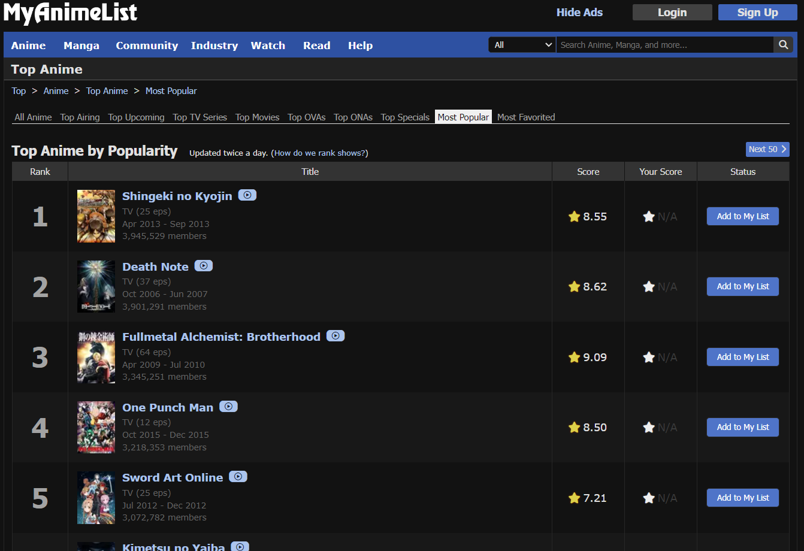
DATA SOURCES AND TOOLS
01
MYANIMELIST.COM
02
CRUNCHYROLL, FUNIMATION
03
STREAMING SERVICES
SUCH AS NETFLIX, PRIME VIDEO, HULU, ETC.

Slide 6
DEMOGRAPHICS
01
JOSEI
02
SHOUJO
03
SEINEN
04
SHOUNEN

Slide 7

EXECUTION:
VISUALS
Distant Viewing
01
Using custom-algorithms to extract and quantify features from video frames, such as colors or shapes.
Shot Boundary Detection
02
Identifying the points at which one shot ends and another begins to compare between male and female characters.

Slide 8

EXECUTION:
VISUALS
Face Detection and Recognition
03
Analyzing characters' presence and interactions within each anime
Analysis of Shot Types
04
Analyzing shot types looks at how different framing techniques (close-ups, long shots, two-shots, etc.) are used throughout the different anime.
Computational Aggregation and Analysis
05
Drawing conclusions from statistical analysis to compare the frequency of different shot types, the presence of characters

Slide 9
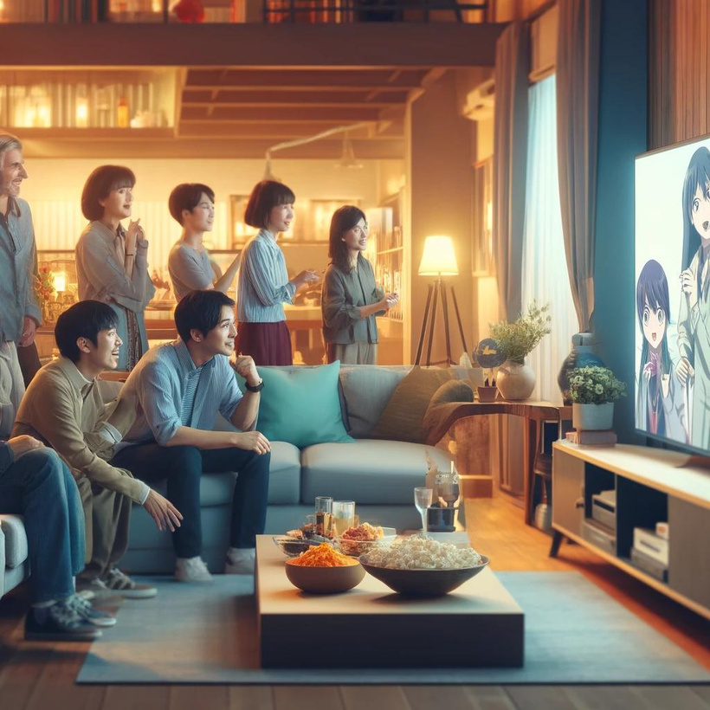
EXECUTION:
FEEDBACK
Crowd Sourcing
Questioning real viewers about how they feel about carefully curated scenes from different anime.

Slide 10

Speech to Text Conversion
01
Converting audio from shows into text using IBM Watson Speech to Text and separate dialogue from non-verbal elements like applause.
Emotion Recognition
02
Using NLP techniques - NRC Emotion Lexicon to associate words to emotions. Next, train a machine learning model on this labeled dataset where dialogues are tagged with emotions.
EXECUTION:
SPEECH
Analysis
03
Drawing conclusions from statistical analysis to compare the frequency of different shot types and the presence of characters

Slide 11
POTENTIAL APPLICATION
POTENTIAL DRAWBACKS
A “Litmus indicator” based on quantifiable factors that can help Manga and Anime companies promote a healthy and realistic image of women.
Lack of interest as the companies, in fact, profit off of the detrimental representation of women
Dangerous application that would overdrive the quantifiable indicators so as to make more profit

Slide 12

THANK YOU!

